Slide 1
Web Accessibility And Cross Platform Development
GIDS TechTalk 2018
Presenters
Miracle Dsouza
Rahul DCosta
Notes:
https://itaccessibility.tamu.edu/help/introduction_web_accessibility.php

Slide 2


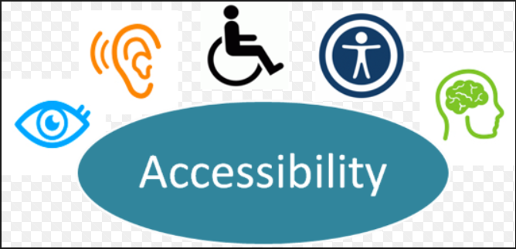
Introduction to Accessibility Web Development
Notes:
An accessible Web provides equal access and equal opportunity for everyone.
Making your site more accessible can increase traffic on your site, improve your site's usability, and raise your search rankings.
There are federal and state regulations which require public universities to have accessible websites.
Accessibility supports social inclusion for people with disabilities as well as others, such as older people, people in rural areas, and people in developing countries.
Accessibility also benefits people without disabilities. The Web Accessibility Perspectives video shows examples of how accessibility is essential for people with disabilities and useful for everyone in a variety of situations.
.Accessibility overlaps with other best practices such as mobile web design, device independence, multi-modal interaction, usability, design for older users, and search engine optimization (SEO). Case studies show that accessible websites have better search results, reduced maintenance costs, and increased audience

Slide 3



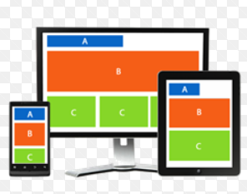
Accessibility development: Benefits
Notes:
Increase the traffic on your site. Building your website to be accessible for all users means you can increase the number of visitors to your site. In the United States, there are an estimated 55 million people with a disability (according to the 2010 U.S. Census), and this number will increase as the population ages. That means if you’re not considering the accessibility of your website, you may be excluding a group of users larger than the population of Canada.
Improve your site’s usability. Think about the automatic doors that open as you enter the grocery store. Many people are physically capable of opening a door for themselves, but those automatic doors make it easier for everyone to access the building. The same is true for an accessible website – it’s easier for everyone to access.
Raise your search rankings. Have you ever heard the phrase Search Engine Optimization (SEO)? The practices used to build accessible websites will also help search engines crawl your pages and catalog your content. Your page rank in popular search engines like Google will very likely improve as the accessibility of your site improves.

Slide 4



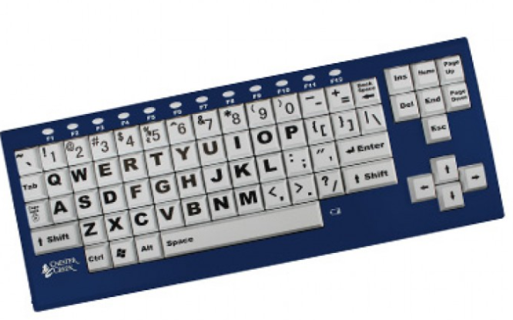
Assistive technology
Screen reader
Screen magnifier
Speech recognition software
Alternative input devices
Notes:
Individuals with disabilities that significantly affect the way they can interact with technology often use assistive technology to help them use computing devices and the web. These tools are very diverse, but here are some examples of commonly used assistive
Screen reader An application that reads content aloud to the user. Screen readers are often used by people with significant visual impairments (i.e., blind or low vision). Consequently, screen reader users are also likely to navigate websites using only a keyboard (a mouse is ineffective for someone who can’t see). Popular screen reader applications are JAWS, VoiceOver, and NVDA.
Screen magnifier An application that magnifies content on the screen. Magnifiers are often used by low vision users, some of whom may be legally blind. A popular screen magnifier is ZoomText.
Speech recognition software An application that uses voice input to perform actions, type, and execute commands. Voice recognition software is especially useful for users with disabilities that limit their motor skills through physical and/or neurological impairments (i.e., motor disabilities). A popular voice recognition application is Dragon NaturallySpeaking.
Alternative input devices Someone with limited mobility or motor disabilities may use any number of input devices to navigate your website, beyond a mouse and keyboard. Some users rely on a keyboard, only. Others will use specialized touchpads or modified keyboards configured for their needs (e.g., large key, large print, or keyboards configured for use with one hand). Still others, who have limited or no mobility from the neck down, may use electronic pointing devices or sip-and-puff systems that are activated by inhaling or exhaling.This is not meant to be an exhaustive list, but hopefully it gives you some idea of the great diversity of tools and modes of access that users may navigate your website with. It’s much more varied than traditional desktops, laptops, tablets, and smartphones.
e tools.

Slide 5
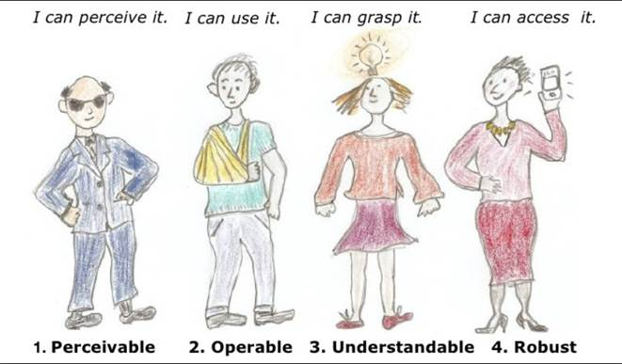
Principles of WCAG 2.O
Features of Accessible Websites
Good use of HTML headings Accessible with keyboard Accessible images Accessible menus Accessible forms Accessible tables Effective use of color Meaningful link text ARIA landmark roles ARIA for web applications

Slide 6
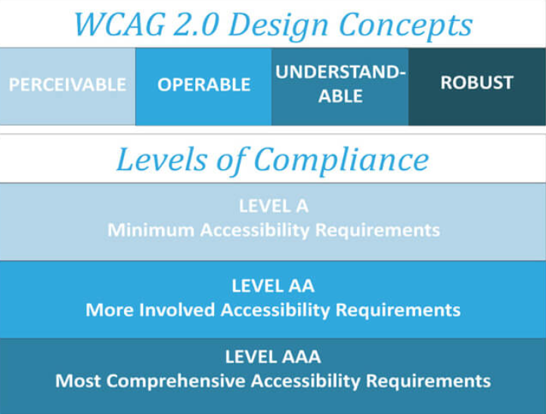
Web Content Accessibility Guidelines(WCAG) 2.0
Notes:
Web Content Accessibility Guidelines (WCAG) 2.0 defines how to make Web content more accessible to people with disabilities
WCAG 2.0 is developed through the W3C process in cooperation with individuals and organizations around the world, with a goal of providing a shared standard for Web content accessibility that meets the needs of individuals, organizations, and governments internationally.
Web accessibility depends not only on accessible content but also on accessible Web browsers and other user agents.

Slide 7
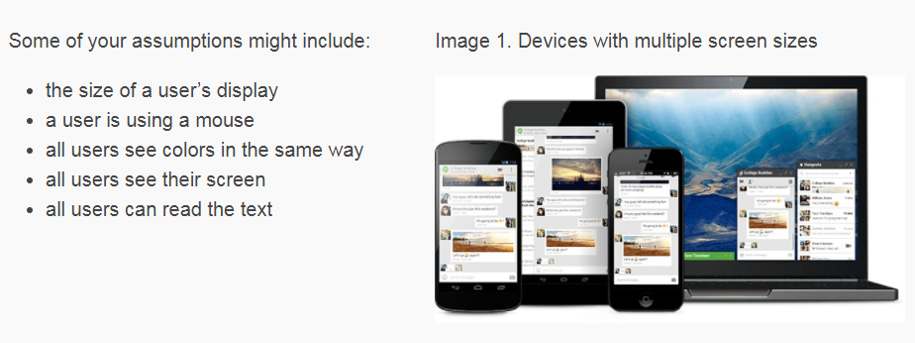
Web Accessibility and Cross platform development

Slide 8
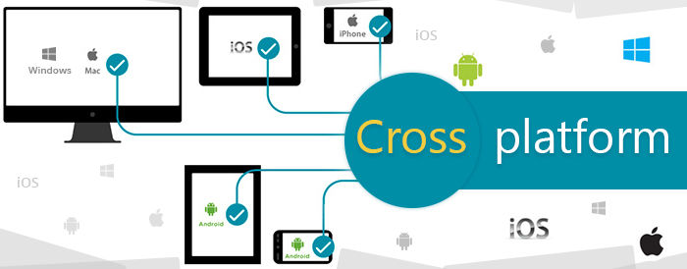
Cross platform development

Slide 9

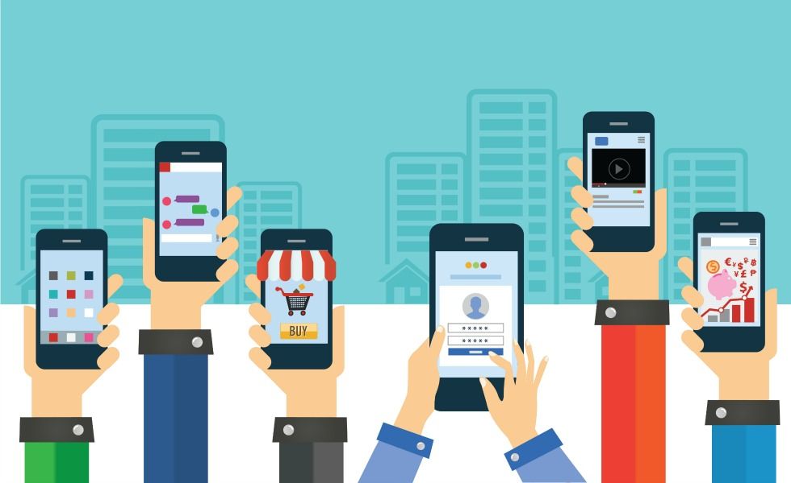
Responsive UI & Mobile first approach
Responsive - Flexible layouts, flexible images and cascading style sheet media queries.
Mobile first approach - Design for smaller screens first – progressive enhancement.
Is there a difference between the two?
mobile-first is actually a design strategy
responsiveness is the result of a technical approach
Notes:
The goal of responsive design is to build web pages that detect the visitor's screen size and orientation and change/adapt/adjust the layout accordingly to look presentable/look good.
1 application- viewed on different devices- single codebasae-----------look is the same
No separate designs &&&&& adapts on the fly/automatically – that makes it a technical approach – the automation or automatic chnge is technicality
Mobile first – is a design approach because its about giving in lot of thots on how u want to see the application on different devices---------------look can vary
Eg: advertisement covering fone screen or menu bar going to two lines or expandable menu(what wud u prefer??????????????)
It’s about starting small n build up for bigger screens – no overhead – no discarding – no wastage –hoaders pain
Incremental- progressive –additive building – scale upwards
Unlike graceful degradation- desktop first –optimal for big screens – lose market on fones – adapt poorly to mobile even if responsive as told in eg
Rui or mfa??????????????????????????????????????????client based

Slide 10
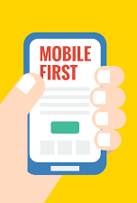
Why Mobile first and responsive UI’s?
Did you know ??
68 million Google searches are carried out on mobile devices every hour around the globe?
What’s more: 69% of travelers start their online searches on a mobile device!
In fact, mobile bookings in the travel industry grew by 1700% between 2011 and 2015, moving from 1% to 18% of online revenues.
Notes:
Shopping trend changed – buying on fones over laptops
Rui: one code base – simple to maintain, save expenditure,easier to handle or improve, no scrolls
MFA: convenient to mobile users, on the fly, better user experience
In gen: ui is face the world sees- backend can be impressive bt the ui has to be attractive and sticky for customers – it has to b pleasing to the eye – the positive vibe plays a big role in shaping a product market.
Shabby – unapproachable will push cust away.
Would u prefer scrolls n header covering ur frst screen or a image which is 2 screens big? If we wudnt – custmorers are finally people like us --- y wud they want something like that?

Slide 11
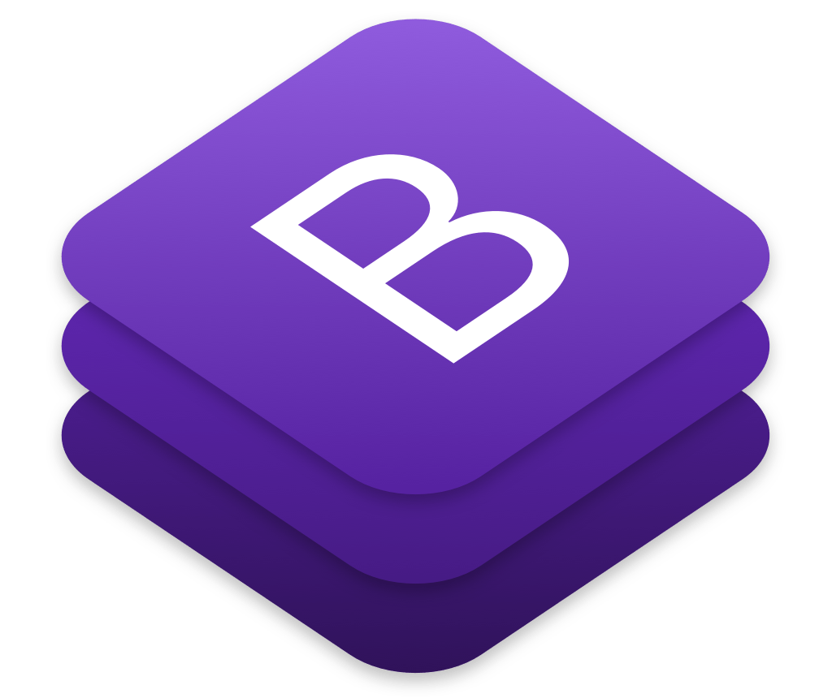
What is bootstrap?
It is a library for responsive, mobile-first projects with the world's most popular front-end component library.
It is an open source toolkit for developing with HTML, CSS, and JS.
Notes:
Lib – ready to use stuff in the form of class
Most popular
Provides html ,css,js templates for typography,forms,buttons,navs and everythn under the sun literally
Easy to use and learn and
easy n quick dev
In place of endless adjustments with margin n padding/display n visibility n spans n div creation-----------simply use classes- ready made--------why wud u cook biryani whenu can make maggi???????

Slide 12

Advantages of Bootstrap
Easy to use
Responsive features
Mobile-first approach
free set of tools /common interface components.
Very less coding
Consistent design
Open source
Compatibility with browsers
Notes:
Easy to use: Anybody with just basic knowledge of HTML and CSS can start using Bootstrap – base to learn other frameworks
Responsive features: Bootstrap's responsive CSS adjusts to phones, tablets, and desktops
The biggest advantage of using Bootstrap is that it comes with free set of tools for creating flexible and responsive web layouts as well as common interface components.
Mobile-first approach: In Bootstrap 3, mobile-first styles are part of the core framework
Additionally, using the Bootstrap data APIs you can create advanced interface components like Scrollspy and Typeaheads without writing a single line of JavaScript.
Save lots of time — You can save lots of time and efforts using the Bootstrap predefined design templates and classes and concentrate on other development work.
Consistent design — All Bootstrap components share the same design templates and styles through a central library, so that the designs and layouts of your web pages are consistent throughout your development.
Open Source — And the best part is, it is completely free to download and use.

Slide 13


